Slide 1
HotCiv Project
Starting up!

Slide 2
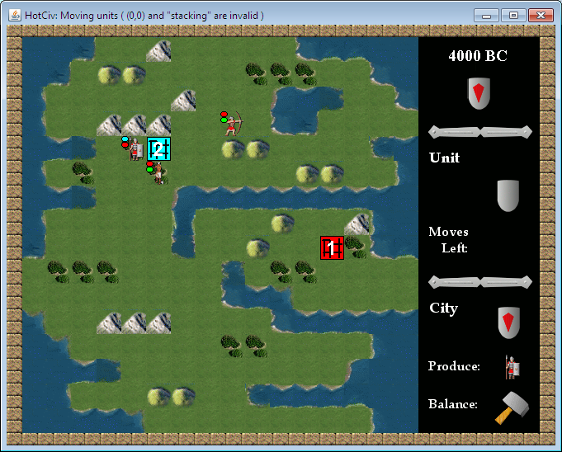
HotCiv = Agile development
Iterations of
  product development
  learning increments
Henrik Bærbak Christensen

Slide 3
Getting Started
Read Chapter 36.1 + 36.2
Download hotciv-tdd-start.zip and unzip it!
Read the java file: Game.java
Source code
  your variant is already fully package’ified
    hotciv.framework etc. packages
    split into a production code and test code source tree
  your variant is already fully Ant’ified
    ‘ant test’ runs out-of-the-box
Henrik Bærbak Christensen

Slide 4
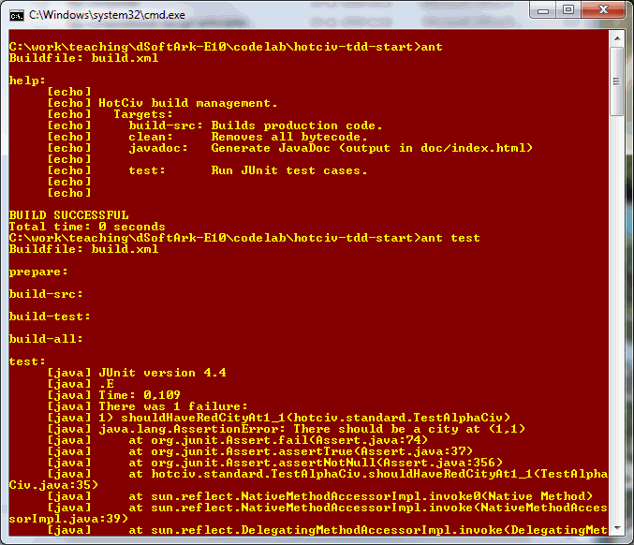
[Demo]
Henrik Bærbak Christensen

Slide 5
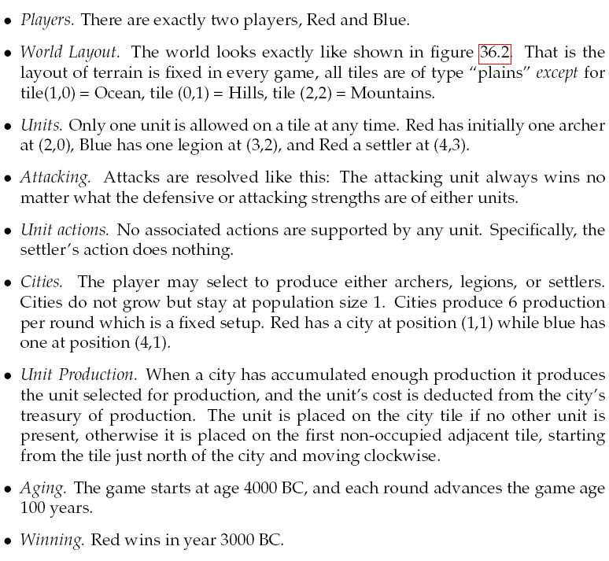
Iteration 1
Implement AlphaCiv
Henrik Bærbak Christensen

Slide 6
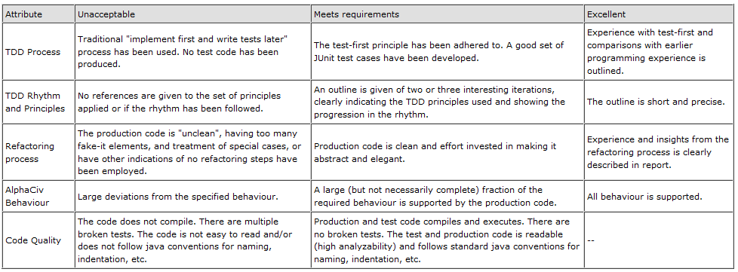
... And write a report on it...
Refer to the ”rubrics” to see what I deem important...
Henrik Bærbak Christensen

Slide 7
The Agile backlog...
This is an architecture course!
  Clean code that works (75% clean > 100% unclean!)
  You may fill in more behaviour in following iterations...
Henrik Bærbak Christensen

Slide 8
... And hand it in...
... Using course admin
Two files
  R.pdf: Report in pdf format
  C.zip: Zip with ALL code
    TA should ”unzip; ant test;” and it should work...
Henrik Bærbak Christensen

Slide 9
... In details...
Henrik Bærbak Christensen

Slide 10
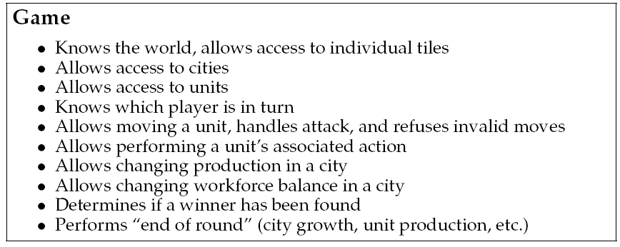
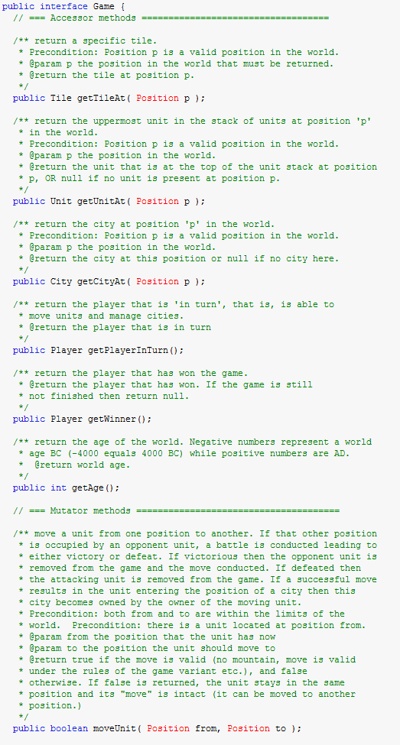
… at the code level
This boils down to implementing relevant methods for the Game interface:
Henrik Bærbak Christensen

Slide 11
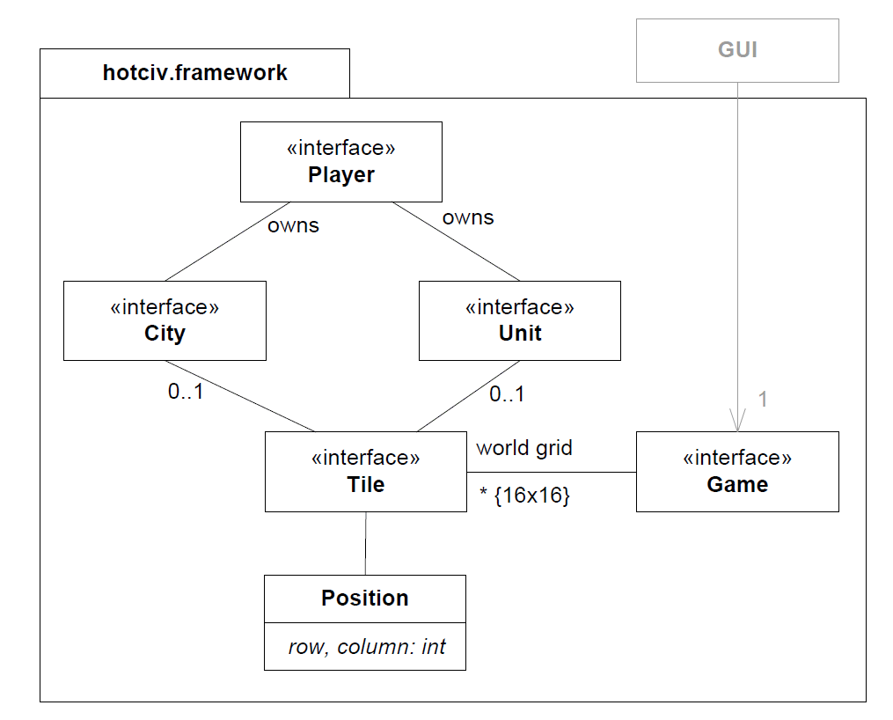

Structure (static view)
Henrik Bærbak Christensen

Slide 12
Dynamics
Generally, consider that the GUI only mutate the game’s state by using the Game’s mutator methods
  endOfTurn, moveUnit, etc.
And only inspect it using either Game accessor methods or the “read-only” interfaces
  getTileAt(p), getCityAt(p), getPlayerInTurn(), …
  Unit, Tile, City’s methods…
Henrik Bærbak Christensen

Slide 13
Some Design Decisions
Keep interfaces intact!
  Otherwise the GUI will have trouble interfacing your HotCiv
Read-only interfaces (Unit, City, …)
  You may
    Add mutator methods to the interface (beware – allows state changes not going through the Game interface!)
    Add mutator methods to StandardX
      Will require quite a bit of casting
String base types
  Enumerations would give better reliability (compiler check) but would delimit future variants ability to add more e.g. more unit types.
Preconditions
  Many game methods require e.g. valid positions. This means you should not make tests for invalid positions!
Henrik Bærbak Christensen

Slide 14
Some Design Decisions
No World abstraction?
  My TDD did not need it so far! Simplicity-the art of maximizing the work not done!
  Introduce it if you find your code maintainability improves.
Henrik Bærbak Christensen

Slide 15
Doing TDD
TDD is about being ’lazy’
  Do not code in anticipation of need, only when need arise! Simplicity – maximize work not done!
Morale:
  Make it as simple as possible!!! Code as little as possible!!!
  Translate the specs into minimal set of test cases. Make the test cases drive the minimal amount of code.
  Do not design the swiss army knife
  Make the code clean!!!
Henrik Bærbak Christensen

Slide 16
Doing TDD
Experience from earlier years
  Test list is a test list
    ‘setup world’ = feature; not a test
    ‘city at (1,1)’ = test; not a feature
    morale: write test lists, not feature lists
  Thinking implementation is bad…
    think “how does my test case look”; not “how do I implement this”
  Thinking too much ahead
    do not foresee problems that never arise
    pick “one step tests”
    be prepared for ‘do over’
Henrik Bærbak Christensen

Slide 17
Doing TDD
You have to constantly refactor
  to make your code clean and abstract
  students tend to forget => junk pile of special cases ☹
Henrik Bærbak Christensen

